Slide 1
A Comparative Analysis of SNARKs and Bulletproofs in Voting Systems
CISC 878: Advanced Cryptographic Techniques Project
Matthew Richard

Slide 2
Overview
1. Introduction
2. Background Zero-Knowledge Proofs SNARKs & Bulletproofs
3. Methodology
4. Results
5. Conclusion

Slide 3
Introduction
Every few years, we face municipal, provincial, and federal elections, in which we gather together as a community to vote for our new representative in different levels of the government.
From decisions on national policies to local schooling and healthcare, in an election, every vote shapes our future.
Unfortunately, elections create many security vulnerabilities that can impact the integrity and privacy of voting.
i.e. Voter Fraud, Duplicate Voting, and Privacy Breaches.
To mitigate an election's security vulnerabilities; I propose the use of zero-knowledge proofs for a voting system.
In my work, I compare two different zero-knowledge proof schemes, SNARKs and Bulletproofs, in a voting domain.

Slide 4
Zero-Knowledge Proofs
Zero-knowledge proofs are a cryptographic method where one party (the prover) convinces another party (the verifier) that a statement is true without revealing anything about the statement.
Zero-knowledge proofs uphold privacy, security, and integrity by allowing verification without revealing sensitive information.

Slide 5
SNARKs (Succinct Non-Interactive Arguments of Knowledge) |  | Bulletproofs
Convert a statement we want to prove into a mathematical equation. Prover and verifier keys are generated in a trusted setup process. The prover generates a proof using the secret value and prover key. The verifier checks the proof using the verifier key. |  | Convert a statement we want to prove into a mathematical equation using range proofs. Public parameters (generators) are created in a setup process that doesn't require trust. The prover generates a proof using the secret value and public parameters. The verifier checks the proof using the public parameters.

Slide 6
Methodology
Language: Rust
Libraries:
arkworks (SNARKs implementation)
bulletproofs (Bulletproofs implementation)
Experimental Process:
Setup: Set up four different parties that can be voted for; Liberal, Conservative, NDP, and Green.
Testing: Manually cast a vote for each of the different parties, prove and verify that each vote belongs to a valid party and the vote is not submitted by a duplicate voter, test duplicate voting to verify that there is an error.
Analysis: Record performance metrics for each valid vote and find the average.

Slide 7
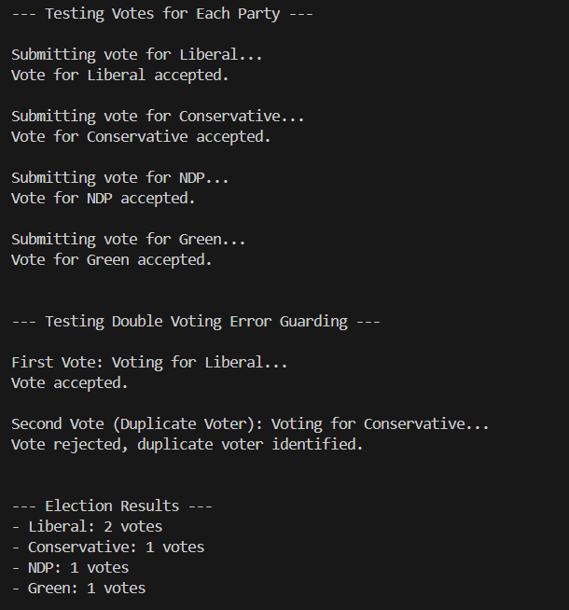

Slide 8
Results
 | SNARKs | Bulletproofs
Average Proof Generation Time | 34.16 ms | 275.36 ms
Average Verification Time | 70.20 ms | 39.94 ms
Average Proof Size | 192 bytes | 488 bytes
Memory Usage | 8 KB | 92 KB

Slide 9
Conclusion
In the voting domain:
SNARKs are more efficient in proof generation, proof size, and memory usage; however, they require a trusted setup which introduces new vulnerabilities and was more challenging to implement.
Bulletproofs are more efficient in verification, do not require a trusted setup, and are less challenging to implement.
Overall, each zero-knowledge proof scheme has their own unique advantages and disadvantages but are both valid approaches for improving election security.

Slide 10
References
[1] Matt Bishop and Sean Peisert. 2012. Security and Elections. IEEE Security & Privacy 10, 5 (2012), 64–67. DOI:https://doi.org/10.1109/MSP.2012.127
[2] Muharman Lubis, Mira Kartiwi, and Sonny Zulhuda. 2016. Election fraud and privacy related issues: Addressing electoral integrity. In 2016 International Conference on Informatics and Computing (ICIC), 227–232. DOI:https://doi.org/10.1109/IAC.2016.7905720
[3] Siqi Liu. 2022. Privacy Protection Revolution: Zero-knowledge Proof. In 2022 International Conference on Data Analytics, Computing and Artificial Intelligence (ICDACAI), 394–397. DOI:https://doi.org/10.1109/ICDACAI57211.2022.00084
[4] Benedikt Bünz, Jonathan Bootle, Dan Boneh, Andrew Poelstra, Pieter Wuille, and Greg Maxwell. 2018. Bulletproofs: Short Proofs for Confidential Transactions and More. In 2018 IEEE Symposium on Security and Privacy (SP), 315–334. DOI:https://doi.org/10.1109/SP.2018.00020

